Slide 1
Ethical Hacking (Task 3)
Submitted By – Pratik Moharkar

Slide 2
Title: Cross Site Scripting Vulnerability
Domain: vulnweb.com
Subdomain: testasp.vulnweb.com

Slide 3
Steps to reproduce
Step 1: Visit http://testasp.vulnweb.com/
Step 2: On the top menu you will find a search option.
Step 3: Click on it and you will be prompted with the Search box.
Step 5: You can find different payloads for XSS. I used “<script>alert(1)</script>” .
Step 6: When you will click on Search, it will show an alert message.

Slide 4
Impact
XSS can have huge implications for a web application and its users. User accounts can be hijacked, credentials could be stolen, sensitive data could be ex-filtrated, and lastly, access to your client computers can be obtained.

Slide 5
mitigation
In general, effectively preventing XSS vulnerabilities is likely to involve a combination of the following measures:
Filter input on arrival: At the point where user input is received, filter as strictly as possible based on what is expected or valid input.
Encode data on output: At the point where user-controllable data is output in HTTP responses, encode the output to prevent it from being interpreted as active content. Depending on the output context, this might require applying combinations of HTML, URL, JavaScript, and CSS encoding.
Use appropriate response headers: To prevent XSS in HTTP responses that aren't intended to contain any HTML or JavaScript, you can use the Content-Type and X-Content-Type-Options headers to ensure that browsers interpret the responses in the way you intend.
Content Security Policy: As a last line of defense, you can use Content Security Policy (CSP) to reduce the severity of any XSS vulnerabilities that still occur.

Slide 6
SCREENSHOTS

Slide 7
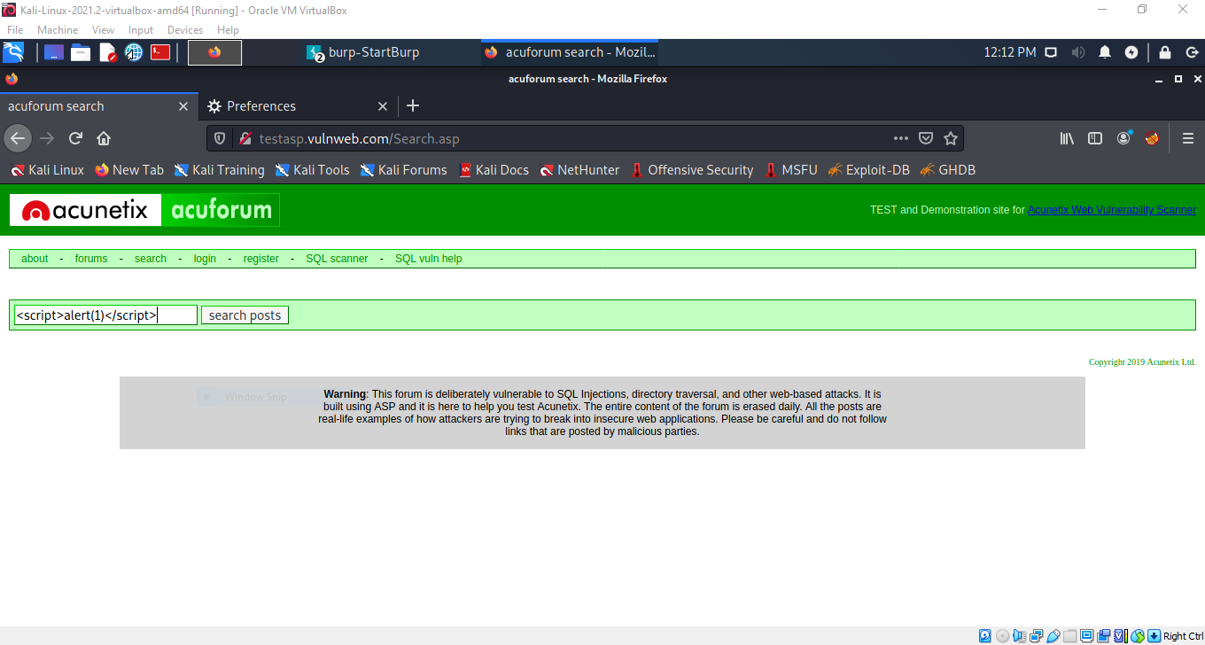

Slide 8
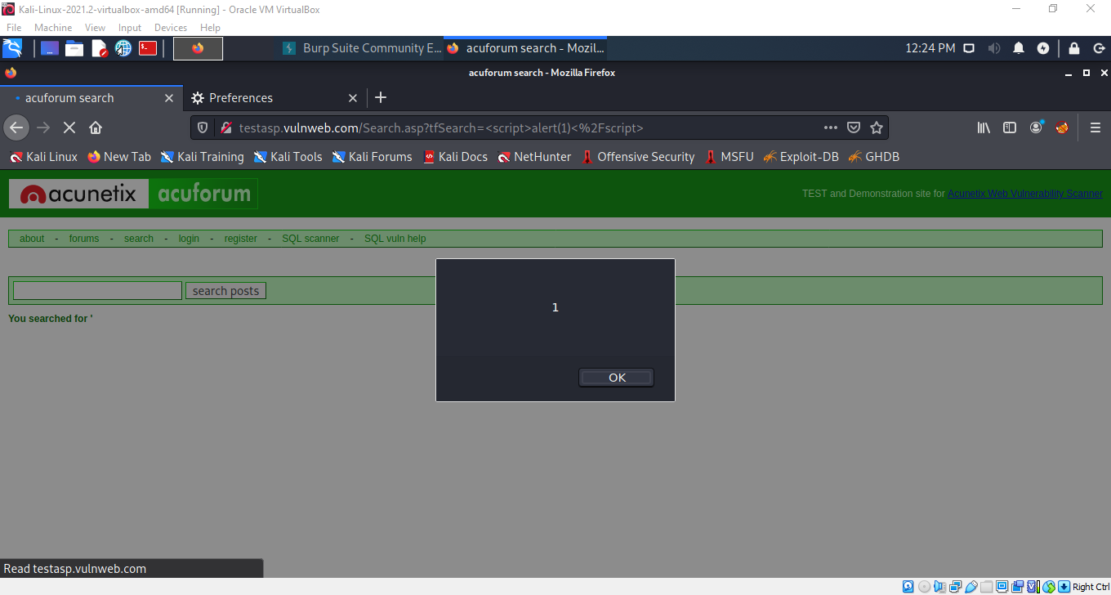

Slide 9
VIDEO Recordings

Slide 10
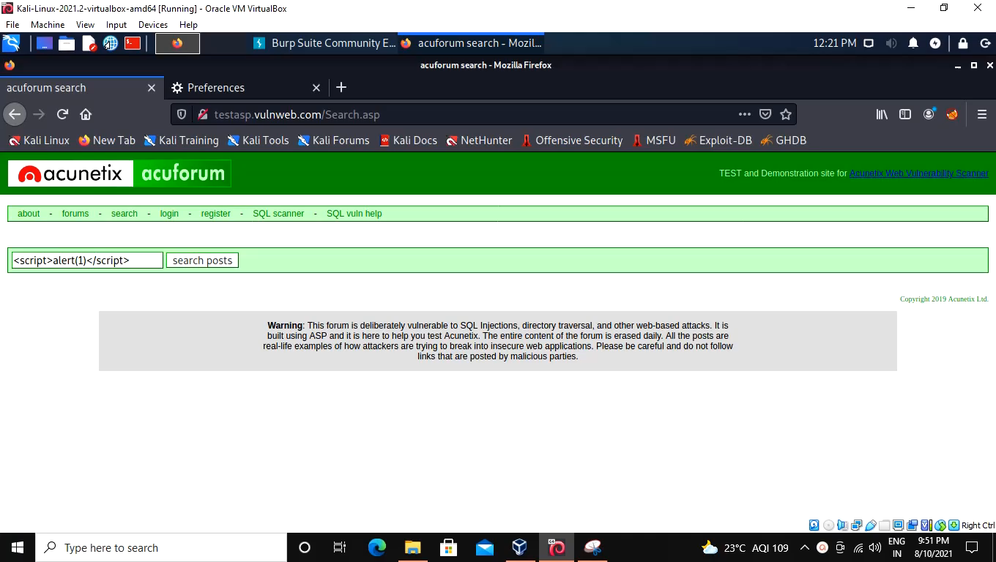

Slide 11
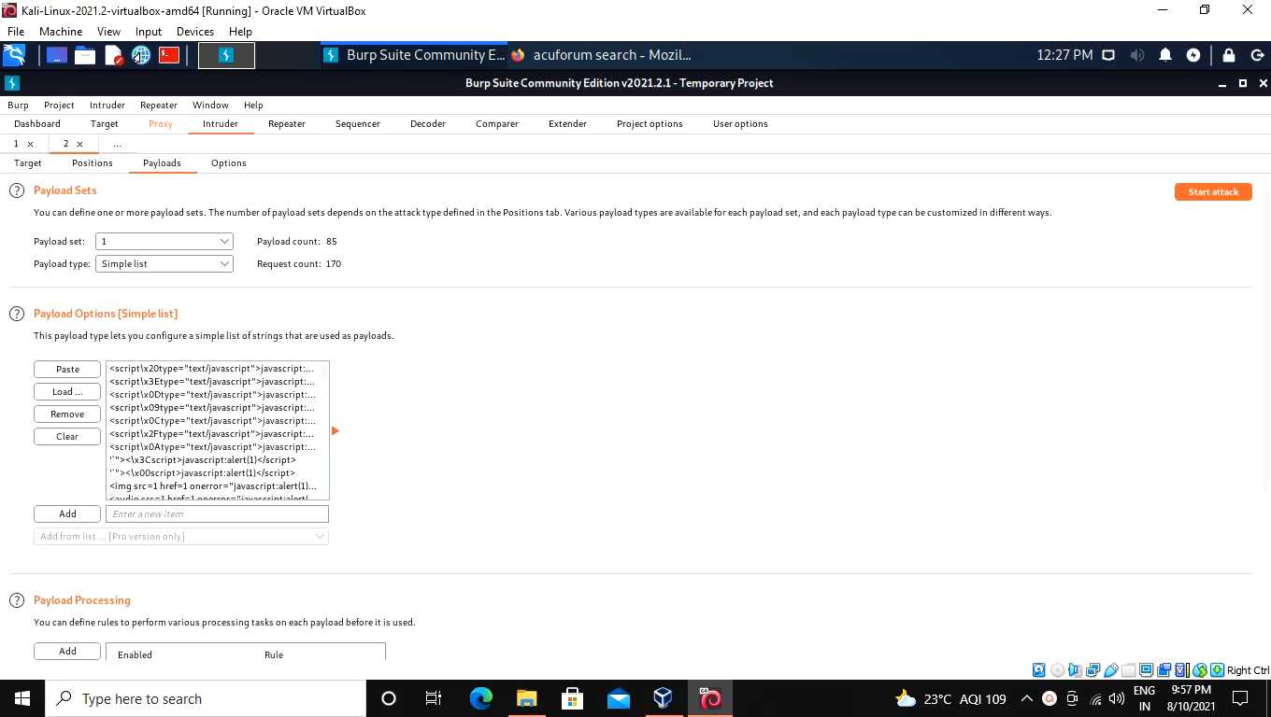

Slide 12
Thank You

